Slide 1
Node2Vec
A Dangerously Short Summary

Slide 2
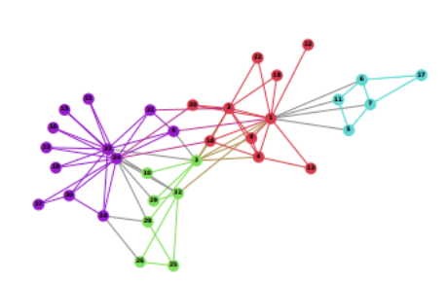
Node2Vec Helps You Go From This
Source - https://tungmphung.com/transforming-everything-to-vectors-with-deep-learning-from-word2vec-node2vec-to-code2vec-and-data2vec/#node2vec

Slide 3
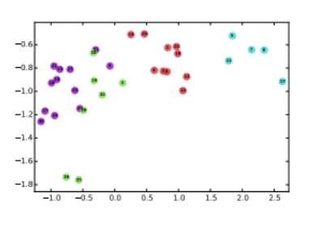
To This
Source - https://tungmphung.com/transforming-everything-to-vectors-with-deep-learning-from-word2vec-node2vec-to-code2vec-and-data2vec/#node2vec

Slide 4
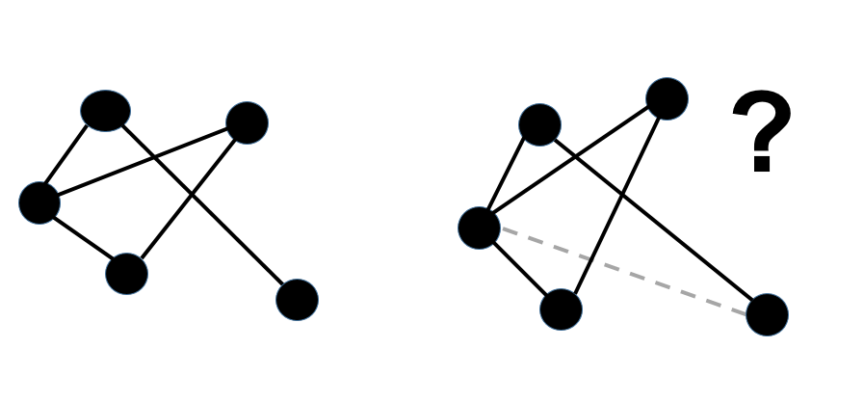
So That You Can Do This (Faster And Better Than Before!)
Source - https://ritikraushan5049.medium.com/link-prediction-using-machine-learning-a2263ca58e22

Slide 5
Major Strengths of Node2Vec
A customizable version of DeepWalk - Go further away or stay closer to nodes, as you wish! (No assumptions on network structure)
Works fast on large networks - Utilizes methods like negative sampling to speed up the algorithm. (No assumptions on network size)
Works better than previous implementations - Faster, more accurate, and is even resistant to perturbations.

Slide 6
Major Weaknesses of Node2Vec
Introduces 2 new hyperparameters (p,q) - We now need to find the optimal values for 6 values (p,q,d,r,l,k)!
May require high dimensions to embed with good quality - We may need to perform dimensionality reduction, reducing the quality of our results!

Slide 7
Some Improvements
The datasets used were all lower than 10,000 nodes in size. Perhaps larger datasets may reveal flaws?
The datasets used were all undirected graphs. Perhaps directed graphs may reveal flaws?
Reducing the number of hyperparameters may lead to faster execution. Further research?

